Slide 1
Guardrails and Prompt Caching
Understanding Safety and Efficiency in AI Agents

Slide 2
A model that generates high-quality outputs but not safe, too slow and expensive to run will not be useful
Guardrails make AI safe, caching makes AI fast

Slide 3



About Me
Sagar Chitransh
Senior Consultant | AI Engineer III
Deloitte
IIT Jodhpur (Rajasthan) Alumnus

Slide 4
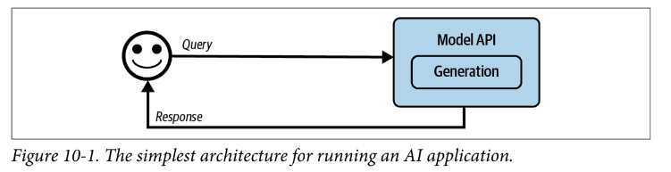
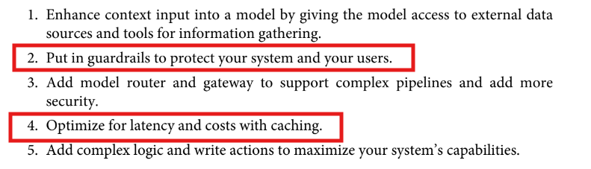
AI Engineering Architecture
MVP
Source : AI Engineering O’REILLY

Slide 5
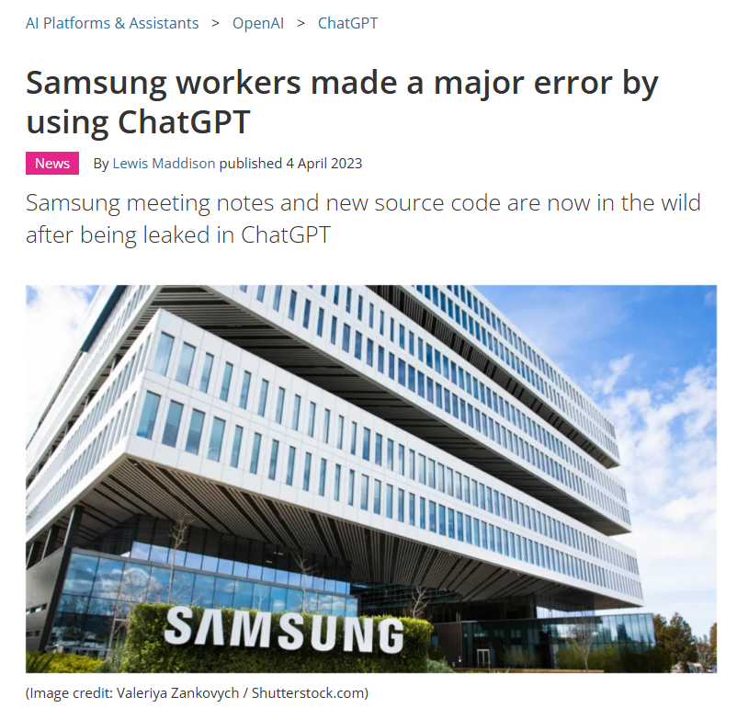
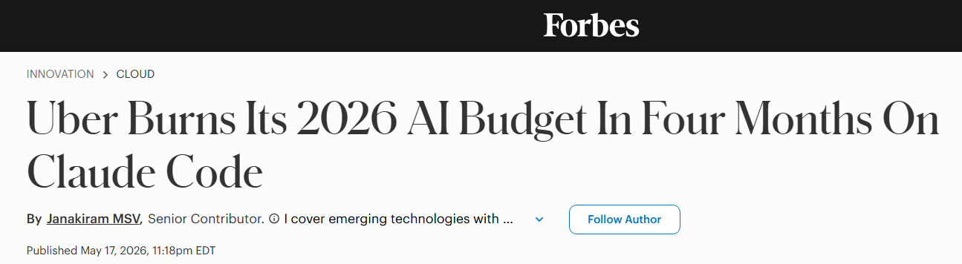
Real Time Examples
COST/BUDGET CHALLENGES
SAFETY CHALLENGES
Source : AI Engineering O’REILLY

Slide 6
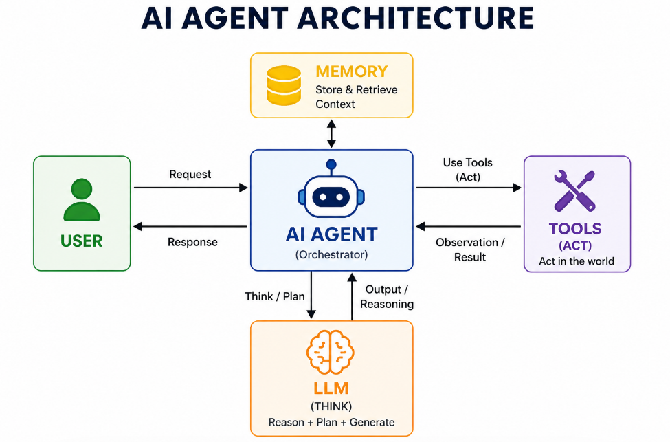

Slide 7
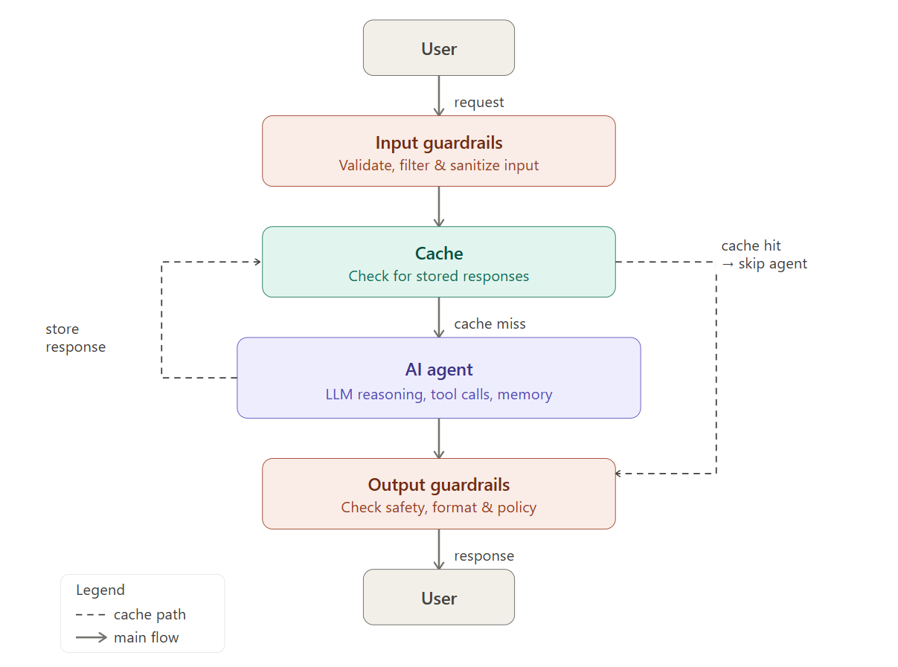
Block Diagram showing guardrails and caching
Guardrails : Protects the system
Caching : Makes the system faster, reduce latency, reuse tokens

Slide 8


Source : BCG News Letter

Slide 9

Guardrails Intuition

Slide 10
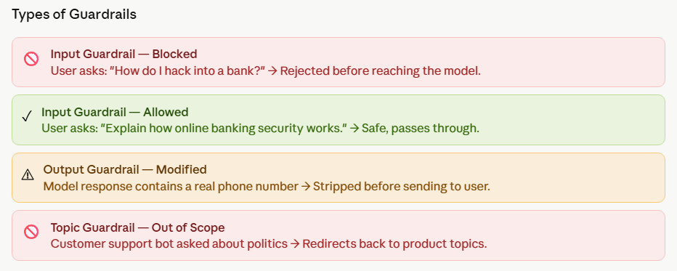
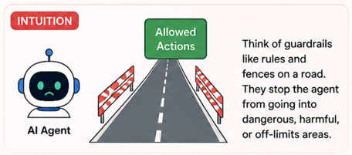
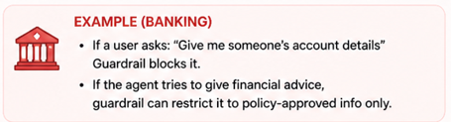
Guardrails are the safety mechanism that controls what goes into and comes out of AI Agents. They sit around your agent pipeline and ensure the agent :
Only processes safe, appropriate inputs
Only performs approved actions
Only returns validated and compliant outputs.
Guardrails help mitigate risks and protect you and your users. They should be placed where there are exposure to risks.

Slide 11
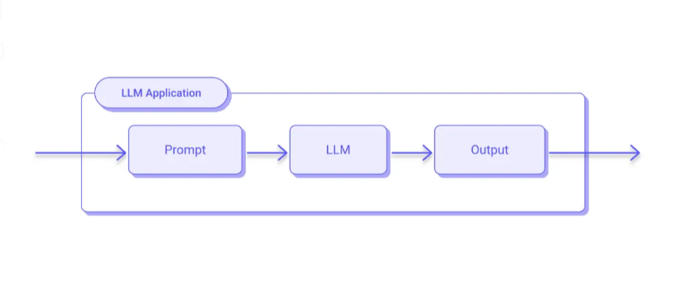
Without Guardrails

Slide 12
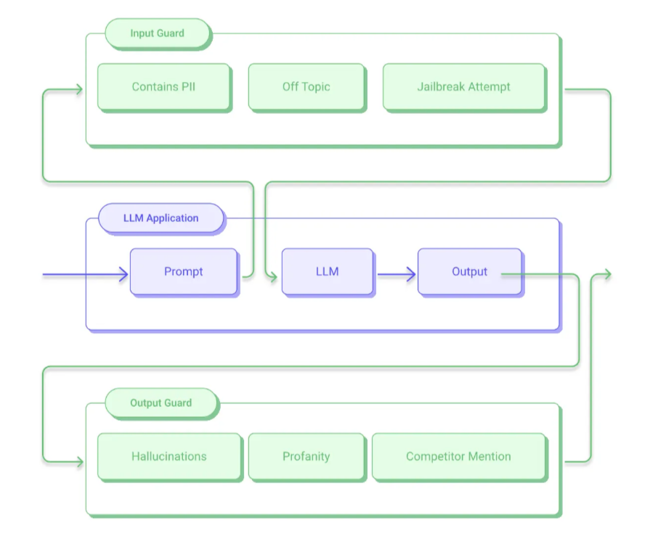
With Guardrails

Slide 13
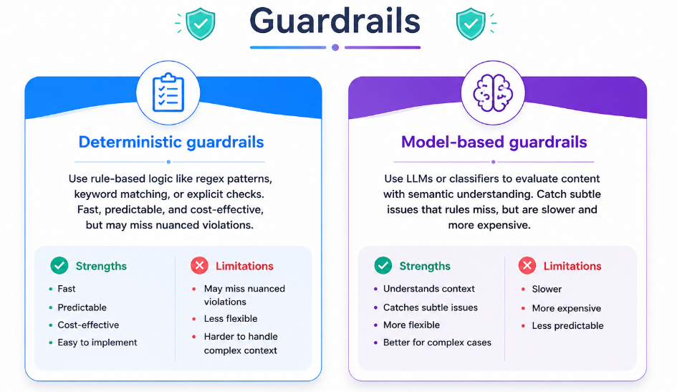

Slide 14

Code Demo : Implementing Guardrails using Langchain (Middleware)

Slide 15
Real Time Guardrails
https://guardrails.openai.com/
https://github.com/openai/openai-guardrails-python
https://github.com/meta-llama/PurpleLlama
https://github.com/microsoft/PyRIT
https://github.com/NVIDIA-NeMo/Guardrails

Slide 16
Code Demo

Slide 17
Prompt Caching
Prompt caching stores responses to frequently asked prompts.
This allows language models to skip redundant processing and retrieve pre-generated responses (cached tokens). It not only saves costs and reduces latency but also makes AI-powered interactions faster and more efficient.
Similar to other applications, the use of caching mechanisms can significantly help optimize LLM request costs and latency.
For instance, according to OpenAI documentation, Prompt Caching can reduce latency by up to an impressive 80% and input token costs by up to 90%.
At its core, prompt caching works by storing prompts and their corresponding responses in a cache. When the same or a similar prompt is submitted again, the system retrieves the cached response rather than generating a new one. This avoids repetitive computation, speeds up response times, and reduces costs.

Slide 18
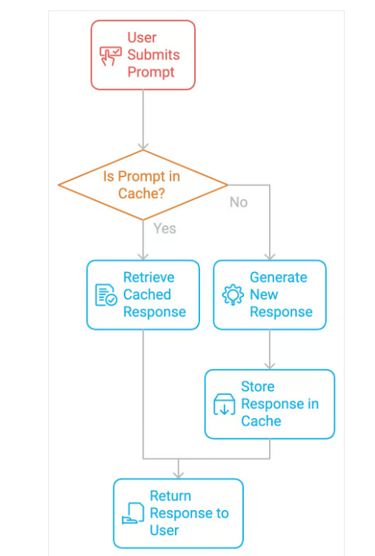
Prompt Caching

Slide 19
Prompt Caching
Why caching is important in Gen AI and Agentic AI ?

Slide 20
Prompt caching stores responses to frequently asked prompts.
Cache States
Cache Hit
Cache Miss
A cache hit occurs when the requested data is found in the cache, allowing for a quick and cheap retrieval.
A cache miss occurs when the data is not in the cache, forcing the application to access the original source, which is more expensive and time-consuming.

Slide 21
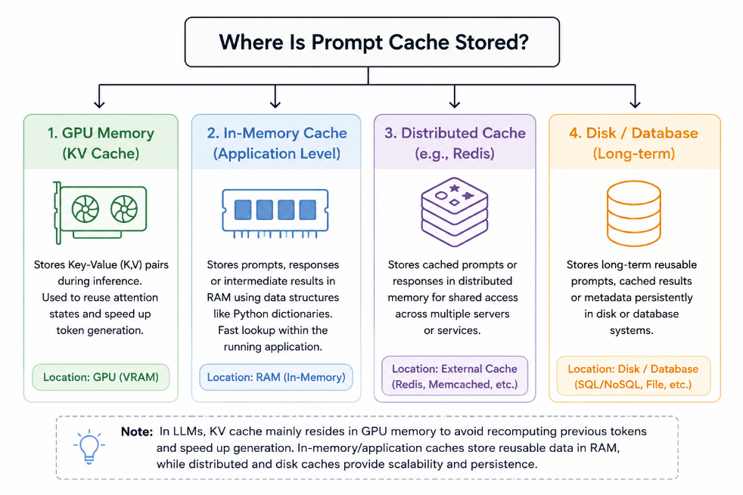
Where Is Prompt Cache Stored?

Slide 22
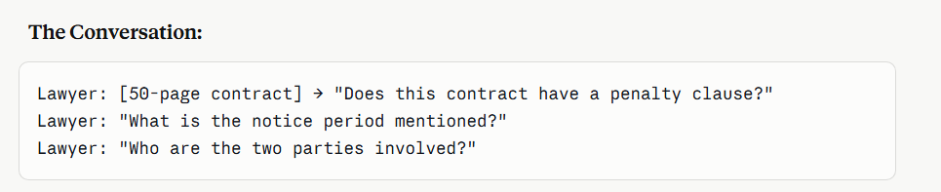
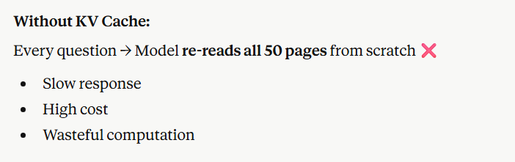
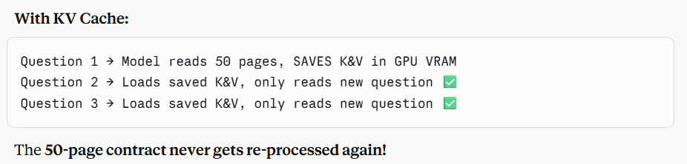
Scenario: A Lawyer Using an AI Assistant
Setup:
A lawyer uploads a 50-page legal contract and asks multiple questions about it.

Slide 23
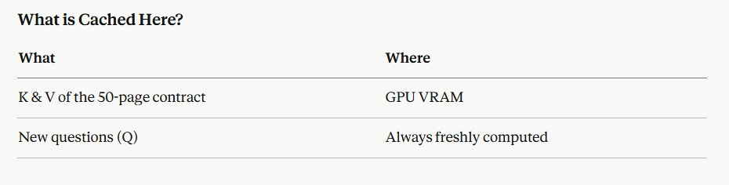
The contract is read once, its meaning is saved in GPU memory, and every new question just looks up that saved meaning like a bookmark in the model's brain.

Slide 24
You are a customer support bot for a pizza shop.
System Prompt (same every time):
"You are a pizza bot. We sell Margherita, Pepperoni, BBQ Chicken. Timings: 9am-11pm..."
Every user asks a different question:
User 1 → "What pizzas do you have?"
User 2 → "What time do you close?"
Without KV Cache → The model re-reads the entire system prompt for every user ❌
With KV Cache → The K & V of the system prompt are computed once and reused for every user. Only the new question is processed ✅

Slide 25
Code Demo

Slide 26
Conclusion
Guardrails keep bad data out of the cache and the model. Cache keeps cost and latency under control. Together they are what makes production-grade agentic AI viable.

Slide 27
Any Questions?

Slide 28
Thank You

